Slide 1


CGB1201 – JAVA PROGRAMMING
Department of Artificial Intelligence and Data Science
Academic Year: 2024 – 2025 (Odd Semester)
Register Number : 2303811724321066
Name :Mohammed Adhil Ameen R
Year :II
Semester :III
Section :B
Date :3.12.24

Slide 2
TITLE OF THE PROJECT
EVENT SCHEDULING SYSTEM

Slide 3
Problem Identification
Unclear user requirements: Users might have varying needs (e.g., event organizers, attendees, venue managers).
Scalability: The system may struggle to handle a large number of users or events simultaneously.
System downtime: Minimizing downtime and ensuring high availability.

Slide 4
Objective
Simplify the scheduling process for organizers and attendees.
Provide tools to manage event details, timelines, and resources efficiently.
Integrate features like reminders, notifications, and real-time updates.
Support multiple languages and time zones for global users.
Prevent underuse or overuse of resources.

Slide 5
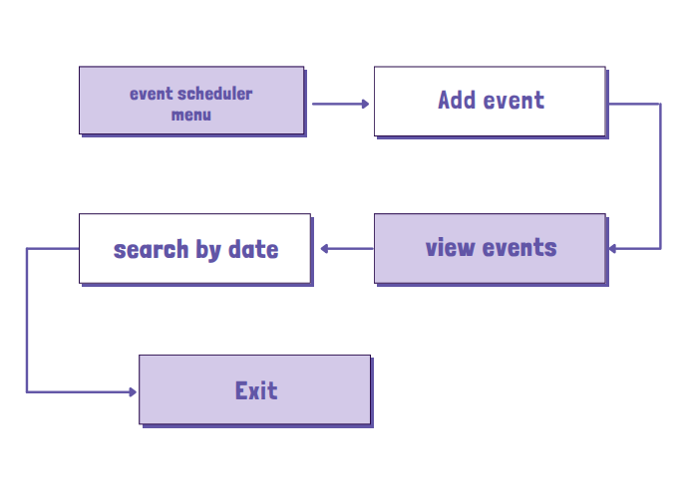
PROPOSED ARCHITECTURE

Slide 6
JAVA PROGRAMMING - CONCEPTS USED
Lists and Sets: To manage collections of events and avoid duplicates.
Maps: To store and retrieve data efficiently
File Handling: To save and retrieve event data
Exception Handling: To manage errors like scheduling conflicts or invalid user inputs gracefully.
Queues/Priority Queues: For managing reminders or scheduling tasks.

Slide 7
List of Modules
User Management Module
User registration and login.
Role management
Profile management.
Event Management Module
Adding, updating, and deleting events.
Managing event details like title, date, time, and location.
Recurring events.

Slide 8
List of Modules
Payment Management Module
Secure payment processing.
Refund management.
Invoice generation.

Slide 9
MODULE DESCRIPTION
User Management Module
User Registration and Login:
Handles user account creation, authentication, and secure login to the system.
Role Management:
Assigns and manages user roles (e.g., admin, organizer, attendee) to control access and permissions.
Profile Management:
Allows users to view, update, and manage their personal information and preferences.

Slide 10
MODULE DESCRIPTION
Event Management Module
Adding, Updating, and Deleting Events: Enables users to create, modify, or remove events from the system.
Managing Event Details: Handles event-specific information such as title, date, time, and location.
Recurring Events: Supports scheduling events that repeat at regular intervals.

Slide 11
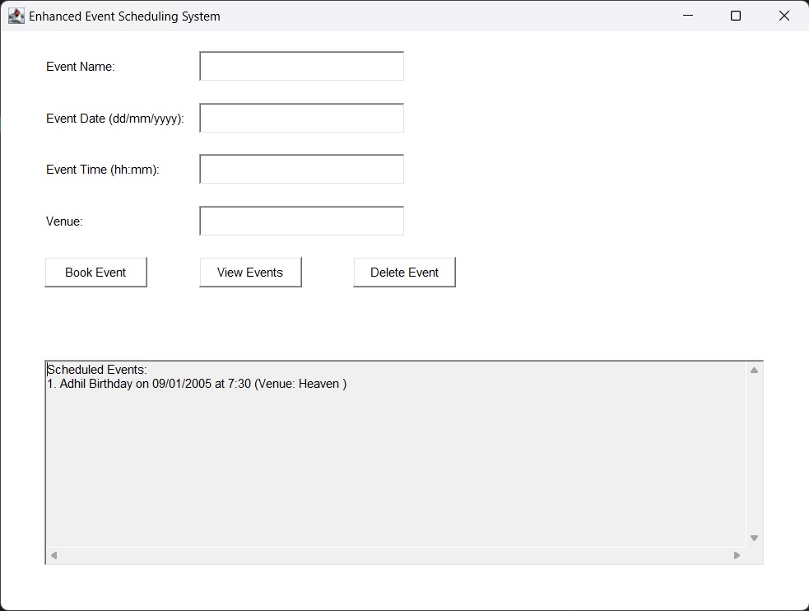
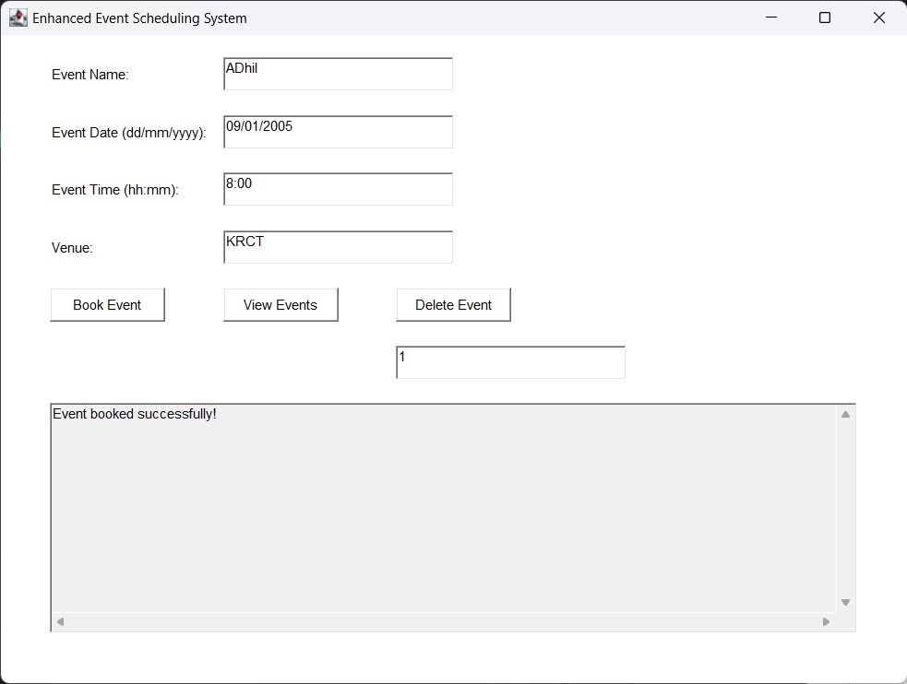
RESULTS AND DISCUSSION

Slide 12
THANK YOU

